Slide 1

Plastic pollution; Biomagnifications
Information Security Fundamentals | Environmental Pollution and Remediation
Course: Information Security Fundamentals | Chapter: Environmental Pollution and Remediation | Program: Bachelor of Engineering
DISCOVER · LEARN · EMPOWER
Notes:
Welcome everyone to today's session on Environmental Pollution and Remediation. We will focus specifically on the critical issues of plastic pollution and the phenomenon of biomagnification. As future engineers, understanding these interconnections is vital for our professional responsibility.

Slide 2
Course Outcomes
SLIDE 2 / 14
Course Outcome
CO | BT LEVEL | DESCRIPTION
CO1 | BT4 | Recall, analyze and respond on fundamental environmental principles, such as ecological relationships and conservation strategies
CO2 | BT4 | Understand and analyze the interconnections between human activities and environmental impacts across different ecosystems
CO3 | BT4 | Understand and analyze and apply environmental laws and policies to analyse and propose solutions for real-world environmental challenges.
CO4 | BT2 | Students will analyse data from environmental monitoring programs to assess trends and predict future impacts on ecosystems.
CO5 | BT6 | Interpret, elaborate and propose various tools, design and innovative strategies for sustainable development and environmental conservation initiatives in securing the planet.
Chandigarh University
2 / 14
Notes:
This lecture directly addresses Course Outcome 2, which requires us to analyze how human activities impact ecosystems. We will see how plastic waste from human sources enters water bodies and moves up the food chain. This analysis is the core of our remediation strategies.

Slide 3
Learning Objectives
SLIDE 3 / 14
Learning Outcomes
1
Analyze the sources and persistence of plastic waste in aquatic ecosystems.
2
Evaluate the process of biomagnification for microplastics and associated toxins.
3
Calculate the concentration increase of pollutants across trophic levels numerically.
4
Assess the ecological risks posed by plastic ingestion to top predators.
5
Propose remediation strategies to mitigate plastic pollution in local water bodies.
Chandigarh University
3 / 14
Notes:
By the end of this session, you will be able to analyze how plastics persist in the environment. You will evaluate how toxins concentrate as they move up the food chain. We will also practice calculating these concentration increases to understand the scale of the problem.

Slide 4
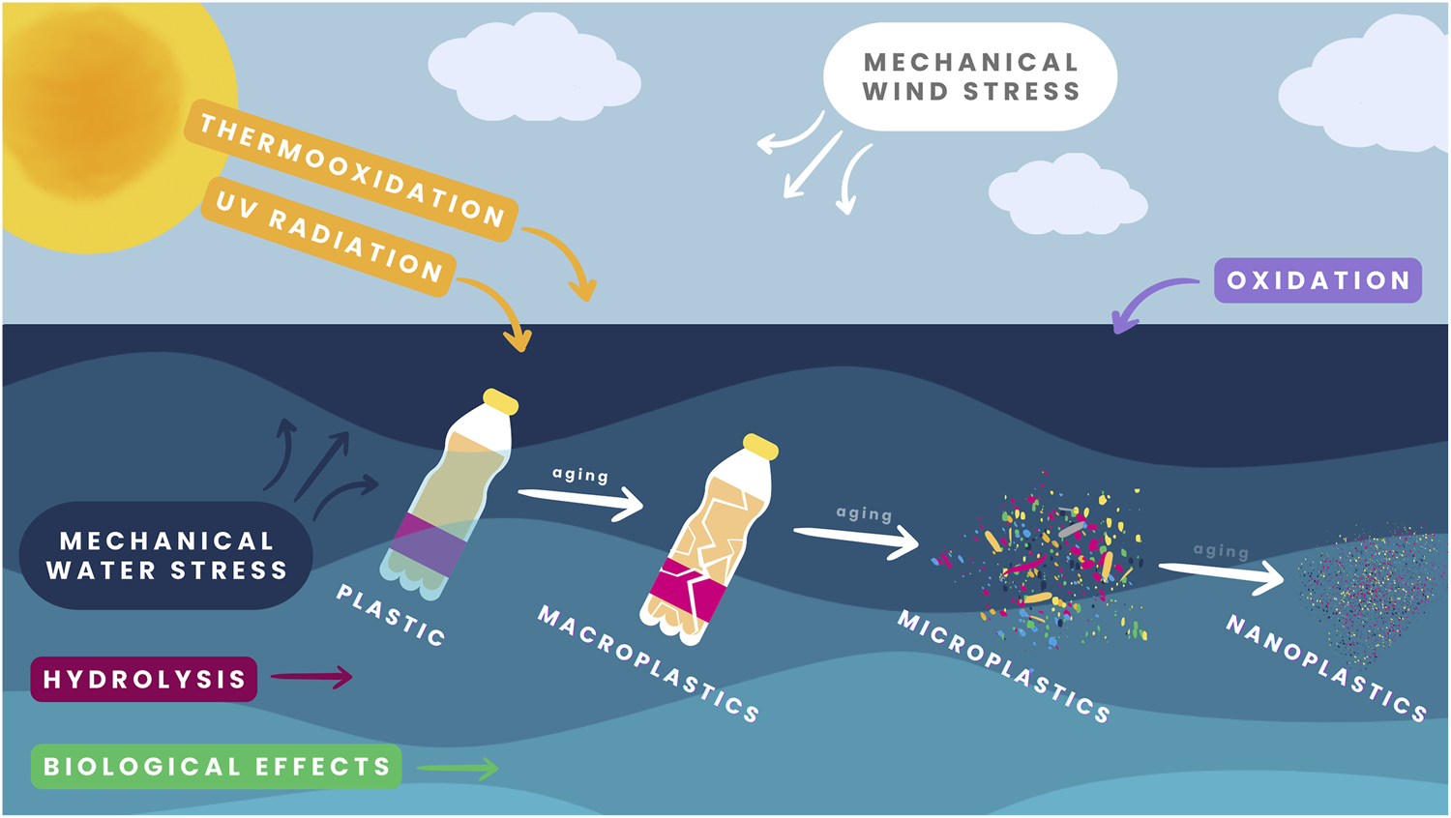
Lecture
SLIDE 4 / 14
Plastic Pollution Sources and Persistence
1
Plastic pollution originates from industrial waste, agricultural runoff, and improper disposal.
2
Synthetic polymers resist natural degradation due to strong carbon-carbon bonds.
3
Microplastics form when larger plastics fragment under UV radiation and wave action.
4
Plastic debris accumulates in oceans, forming massive garbage patches like the Great Pacific.
5
Persistence leads to long-term habitat alteration for aquatic organisms and birds.
6
Single-use plastics contribute the highest volume of waste entering water systems annually.
7
Degradation time for a plastic bottle can exceed 450 years in marine environments.
Frontiers | Plastic degradation in aquatic environments: a review of challenges and the need for standardized experimental approaches
Chandigarh University
4 / 14
Notes:
Plastics are persistent because their chemical structure resists breakdown by bacteria or sunlight. A single plastic bottle can take over 450 years to decompose fully. This persistence means that every piece of plastic ever made still exists somewhere in the environment today.

Slide 5
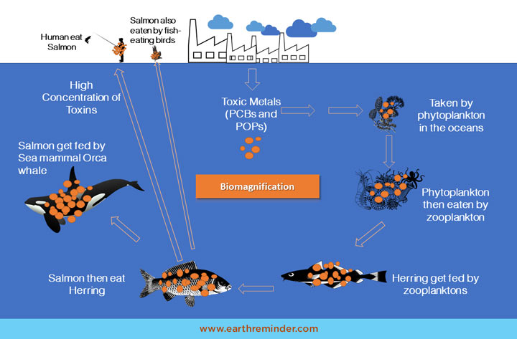
Lecture
SLIDE 5 / 14
Mechanism of Biomagnification
1
Biomagnification is the increasing concentration of toxins in organisms at higher trophic levels.
2
Plastics act as vectors for hydrophobic pollutants like PCBs and DDT to enter food webs.
3
Organisms cannot metabolize these toxins, causing them to accumulate in fatty tissues.
4
The concentration factor increases with each step up the food chain significantly.
5
Top predators accumulate the highest toxin loads due to cumulative ingestion over time.
6
Biomagnification differs from bioaccumulation which occurs within a single organism's lifetime.
7
The process is driven by the inefficiency of energy transfer and toxin retention.
Biomagnification - Causes and Effects with Examples | Earth Reminder (source: www.earthreminder.com)
Chandigarh University
5 / 14
Notes:
Biomagnification is distinct from simple accumulation because it involves the food chain. Toxins stick to plastic particles, which are eaten by small fish, then larger fish. Each step up the pyramid results in a higher concentration of the toxin in the predator's body.

Slide 6
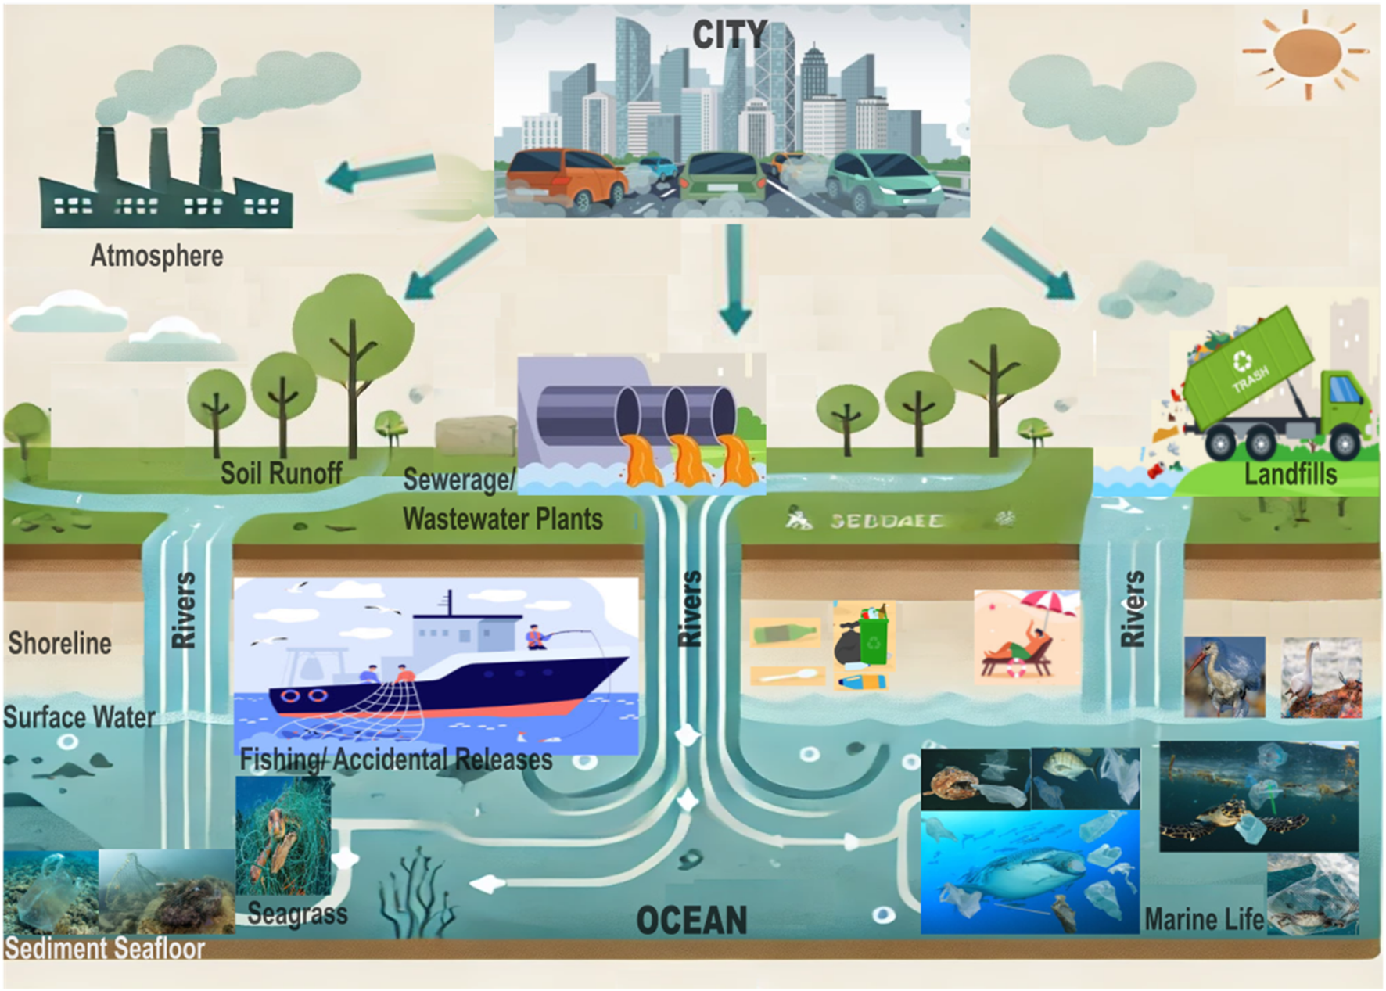
Lecture
SLIDE 6 / 14
Role of Microplastics in Toxin Transport
1
Microplastics have a high surface-area-to-volume ratio enhancing pollutant adsorption.
2
Hydrophobic contaminants bind strongly to the hydrophobic surface of plastic particles.
3
Small organisms ingest microplastics mistaking them for food particles like plankton.
4
Once ingested, toxins desorb from plastic into the organism's fatty tissues.
5
Microplastics facilitate the transfer of persistent organic pollutants from water to biota.
6
The presence of microplastics accelerates the rate of biomagnification in aquatic systems.
7
Plastic additives like phthalates also leach out, adding to the toxic load.
Frontiers | Plastics pollution: pathways, impacts, and regulatory challenges in marine environments (source: www.frontiersin.org)
Chandigarh University
6 / 14
Notes:
Think of microplastics as tiny sponges for toxins. Because they are so small, they are easily eaten by plankton. The toxins stick to the plastic, and when the plankton is eaten, the toxins are transferred to the fish, effectively moving the poison up the chain.

Slide 7
Lecture
SLIDE 7 / 14
Ecological Impacts on Aquatic Life
1
Ingestion of plastics causes physical blockage and false satiety in marine animals.
2
Toxin accumulation leads to reproductive failure and reduced survival rates in species.
3
Biomagnification threatens apex predators like eagles, sharks, and seals with lethal doses.
4
Behavioral changes occur in fish exposed to endocrine-disrupting chemicals from plastics.
5
Ecosystem stability is compromised as key species populations decline due to toxicity.
6
Bioaccumulation of heavy metals on plastic surfaces further exacerbates toxicity risks.
7
Long-term exposure results in genetic mutations and developmental abnormalities in offspring.
Frontiers | Plastics pollution: pathways, impacts, and regulatory challenges in marine environments (source: www.frontiersin.org)
Chandigarh University
7 / 14
Notes:
The ecological impact is severe and multifaceted. Animals often die from starvation because their stomachs are full of indigestible plastic. Furthermore, the toxins cause reproductive failure, meaning the population cannot replenish itself, leading to a decline in apex predators.

Slide 8
Worked Numerical Example
SLIDE 8 / 14
Biomagnification Factor
GOVERNING EQUATION
Concentration in zooplankton = 0.01 mg/kg × 100 = 1.0 mg/kg
1
Assume water concentration of pollutant is 0.01 mg/kg in the base level.
2
Primary consumers (zooplankton) have a bioconcentration factor of 100.
3
Secondary consumers (small fish) have a biomagnification factor of 10 relative to prey.
4
Concentration in small fish = 1.0 mg/kg × 10 = 10.0 mg/kg.
5
Tertiary consumers (large fish) have a factor of 10 relative to small fish.
6
Final concentration in large fish = 10.0 mg/kg × 10 = 100.0 mg/kg.
Biomagnification - Causes and Effects with Examples | Earth Reminder (source: www.earthreminder.com)
Chandigarh University
8 / 14
Notes:
Let's look at the numbers. If the water has 0.01 mg/kg of a toxin, zooplankton concentrate it 100 × to 1.0 mg/kg. Small fish eat the zooplankton and concentrate it another 10 × to 10 mg/kg. Finally, large fish reach 100 mg/kg, which is 10,000 × the original water concentration.

Slide 9
Lecture
SLIDE 9 / 14
Common Pitfalls in Biomagnification Analysis
1
Confusing bioaccumulation (within one organism) with biomagnification (across trophic levels).
2
Assuming all plastics degrade quickly in marine environments without UV exposure.
3
Ignoring the role of lipid solubility in determining toxin retention rates.
4
Overlooking the contribution of plastic additives as independent toxicants.
5
Failing to account for the varying metabolic rates of different species.
6
Assuming linear growth in concentration without considering saturation effects.
7
Neglecting the difference between ingestion of plastic and ingestion of toxins.
Biomagnification - Causes and Effects with Examples | Earth Reminder (source: www.earthreminder.com)
Chandigarh University
9 / 14
Notes:
A common mistake is confusing bioaccumulation with biomagnification. Bioaccumulation happens within one animal, while biomagnification happens as you move up the food chain. Also, do not assume all plastics degrade quickly; many persist for centuries, continuously releasing toxins.

Slide 10
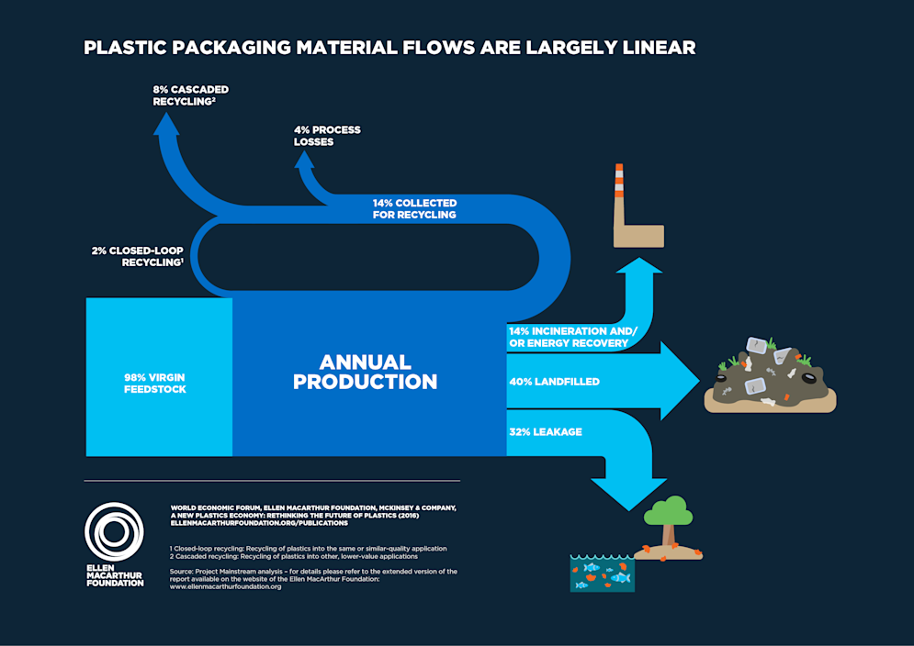
Remediation Strategies
SLIDE 10 / 14
Source Reduction
1
Implementing bans on single-use plastics reduces the total volume of waste generated.
2
Promoting biodegradable alternatives like PLA reduces long-term environmental persistence.
3
Improving waste management infrastructure prevents plastic leakage into water bodies.
4
Public awareness campaigns encourage behavioral changes in consumption habits.
5
Extended Producer Responsibility laws force manufacturers to manage end-of-life waste.
6
Circular economy models prioritize reuse and recycling over linear disposal.
7
Policy interventions must target the most persistent and harmful plastic types first.
Source: images.ctfassets.net
Chandigarh University
10 / 14
Notes:
The most effective remediation is stopping the pollution at the source. Banning single-use plastics and promoting biodegradable alternatives can drastically reduce the load. We must also enforce Extended Producer Responsibility, making manufacturers accountable for the waste they create.

Slide 11
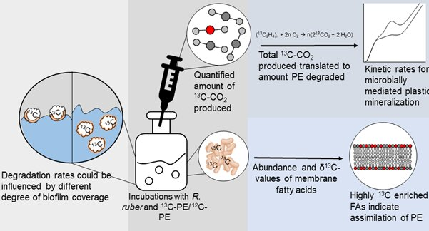
Remediation Strategies
SLIDE 11 / 14
Bioremediation
1
Certain bacteria and fungi can degrade specific types of synthetic polymers.
2
Enzymatic degradation uses enzymes like PETase to break down plastic chains.
3
Bioremediation is effective for microplastics in controlled environments like treatment plants.
4
Genetic engineering enhances microbial strains to target persistent plastic pollutants.
5
Bioremediation offers a sustainable solution compared to energy-intensive incineration.
6
Field application requires careful monitoring to prevent ecological disruption.
7
Combining bioremediation with physical collection improves overall cleanup efficiency.
Source: scx2.b-cdn.net
Chandigarh University
11 / 14
Notes:
Bioremediation uses nature's own cleaners. Certain bacteria and fungi can actually eat plastic. Scientists are even engineering enzymes like PETase to speed up this process. While promising, this method is best used in controlled settings or as part of a larger cleanup strategy.

Slide 12
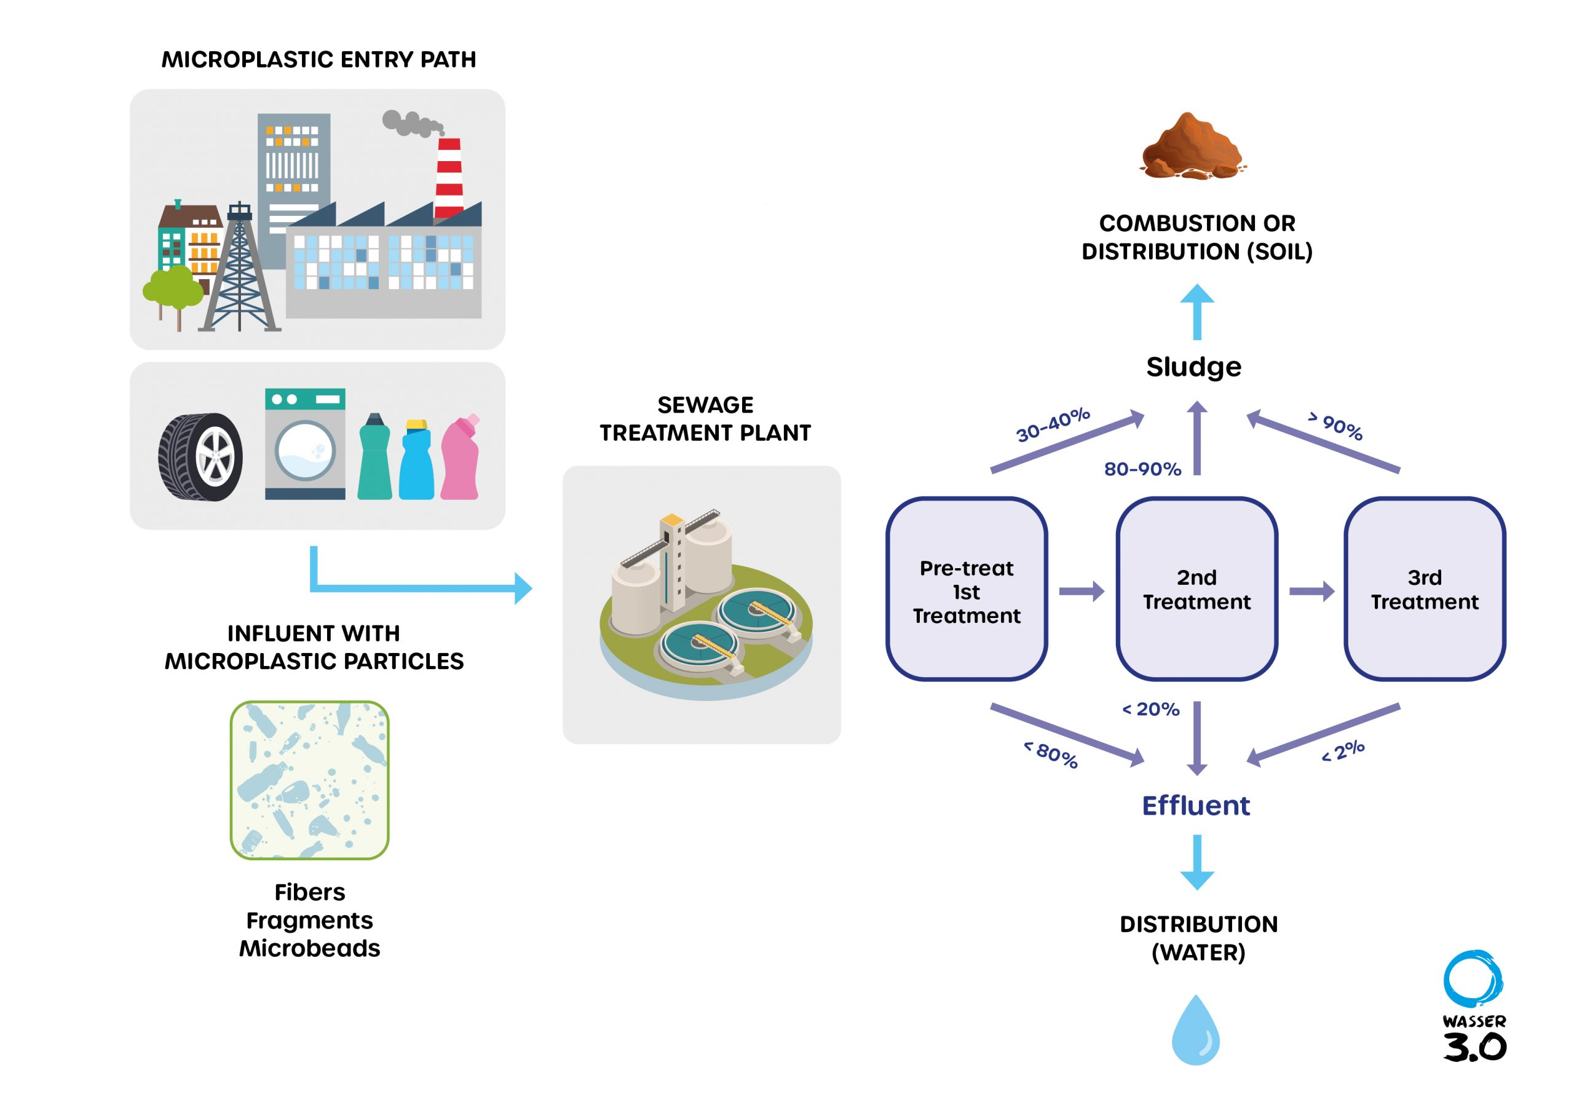
Remediation Strategies
SLIDE 12 / 14
Physical and Chemical
1
Mechanical collection removes macroplastics from water surfaces and shorelines.
2
Filtration systems in wastewater plants capture microplastics before discharge.
3
Chemical recycling converts plastic waste back into monomers for new production.
4
Incineration with energy recovery reduces volume but requires strict emission controls.
5
Advanced oxidation processes degrade dissolved organic pollutants associated with plastics.
6
Physical barriers prevent plastic drift into sensitive marine ecosystems.
7
Integrated approaches combining multiple methods yield the best remediation results.
Source: wasserdreinull.de
Chandigarh University
12 / 14
Notes:
Physical methods like filtration and collection are immediate solutions for removing plastic. Chemical recycling offers a way to turn waste back into raw materials. However, incineration must be carefully managed to avoid releasing toxic fumes into the atmosphere.

Slide 13
Lecture
SLIDE 13 / 14
Key Takeaways
1
Plastic pollution persists for centuries and acts as a vector for toxic pollutants.
2
Biomagnification causes toxin concentrations to increase exponentially up the food chain.
3
Microplastics significantly enhance the transfer of hydrophobic contaminants to aquatic life.
4
Numerical analysis shows concentration factors can reach thousands of × the original level.
5
Effective remediation requires a mix of source reduction, bioremediation, and physical cleanup.
6
Understanding these mechanisms is essential for engineering sustainable environmental solutions.
Chandigarh University
13 / 14
Notes:
To summarize, plastics are persistent and carry toxins that magnify up the food chain. The numerical examples show how dangerous these concentrations can become for top predators. Finally, we must use a combination of reduction and cleanup strategies to solve this crisis.

Slide 14
Lecture
SLIDE 14 / 14
References
ENVIRONMENTAL STUDIES
From Crisis to Cure — R. Rajagopalan
• Environmental Science and Engineering — Benny Joseph
• Environmental Studies — R.C. Sharma and D. Gurbir Sangha
• Introduction to Environmental Science — Anjaneyulu, Y.
• Environmental Pollution Control Engineering — C.S. Rao
• Textbook of Environmental Studies for undergraduate courses — E. Bharucha
• Environmental Science — S.C. Santra
Chandigarh University
14 / 14
Notes:
These textbooks provide the foundational knowledge for the concepts discussed today. I encourage you to read the chapters on pollution and remediation for deeper insights. They cover the engineering principles and environmental impacts in great detail.

